Slide 1
St James CE Primary School
Year 4 Curriculum Presentation

Slide 2
Your Team
Year 4
Miss Merryweather (Phase Leader)
Miss Sanghera/Mrs Thomas (Year 4 teacher)
Mrs Savin (LSP)
Mrs Hargun (LSP)
Mr Dawson (LSP)
Mrs Hey (Cover)
Miss Hipkiss (Cover)

Slide 4
Ready to Learn Behaviour System
Between each stage, children are given opportunities to change their behaviour. A range of positive behaviour management strategies, including warnings or reminders will be given before a consequence. Children will be given the opportunity to move from the negative consequence stage back to the positive – back to green and above.

Slide 5
Online Safety
At St James CE Primary School, we believe that educating children about being safe online is crucial part of growing up in the 21st Century. Our Computing curriculum has online safety embedded throughout, focusing on identifying some of the risks of using the internet and how it keeps you safe. It also forms part of our PSHE education and is regularly discussed in class and in assemblies.
Be Safe Online at Home
There are many ways you can help with being safe online at home. With all types of devices in the home now being internet connected, it is more important than ever to protect yourself and your family from potential issues online.
The following websites provide lots of useful information and tips (they can also be found on our school website):
Thinkuknow Parent Helpsheet
https://parentinfo.org/
https://tutorful.co.uk/guides/how-to-keep-kids-safe-online

Slide 6
Lines of Communication
Class
Teacher
Phase Leader
Deputy Head
Head Teacher
You can leave messages for your child’s class teacher by calling the office on 0121 552 5491,
emailing contact.us@stjamespri.uk or messaging on ARBOR.

Slide 7
Uniform
The St James school uniform consists of:
All children (Nursery – Year 6) need:
burgundy St James crew neck sweatshirt/sweatshirt cardigan
white polo t-shirt or shirt
grey or black school trousers/skirt/pinafore dress
black flat sensible school shoes (shoes are to be plain with no coloured logos)
St James book bag
In warm weather girls may wear a red gingham dress and boys grey/black shorts
Optional burgundy St James zip fleece
In warm weather caps and sunglasses are encouraged
Children wear PE kit on days that we have PE every Friday and some Mondays which we will let you know.
PE kit is a plain t-shirt and black or blue tracksuit trousers, shorts or leggings

Slide 8
Homework – Lower KS2
• Reading daily
• A spelling list will be provided each week on a specific day and tested on the following week.
• Learning times tables using Times Tables Rockstars (continuing with 2, 5 and 10 and
learning of multiplication facts 3, 4, 6, 7, 8, 9, 11 when ready).
• Purple mash, spelling shed, letter join
Independent research of topic areas

Slide 9
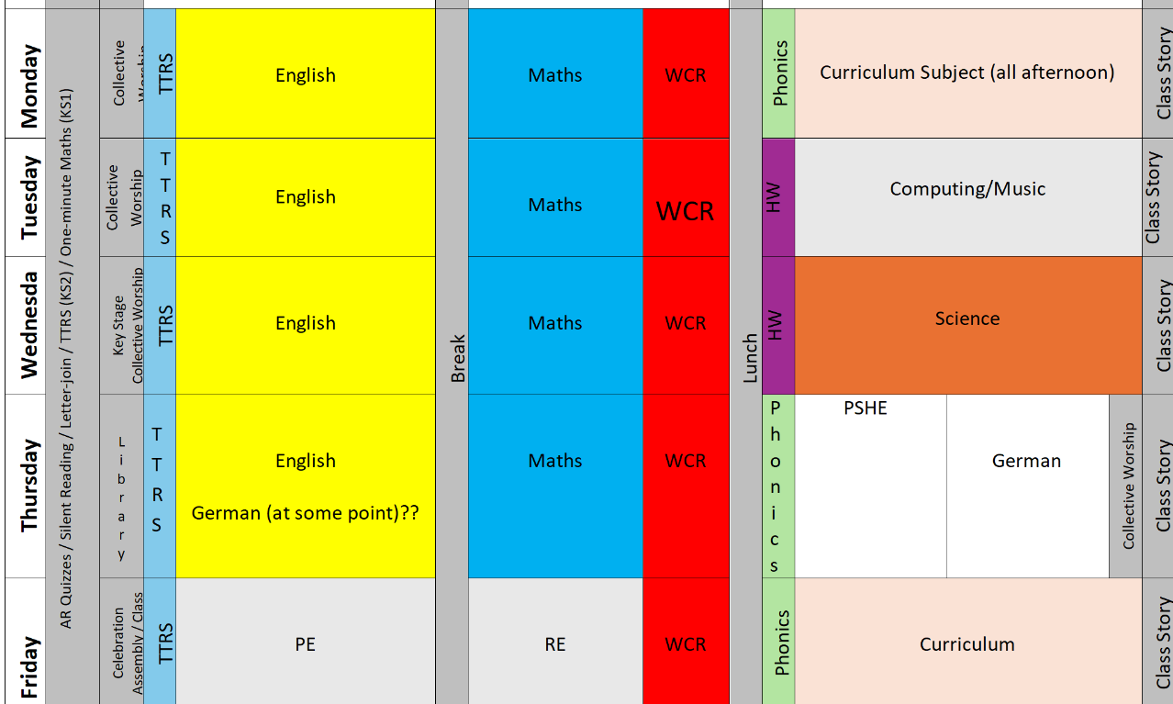
Our Daily Routine

Slide 10
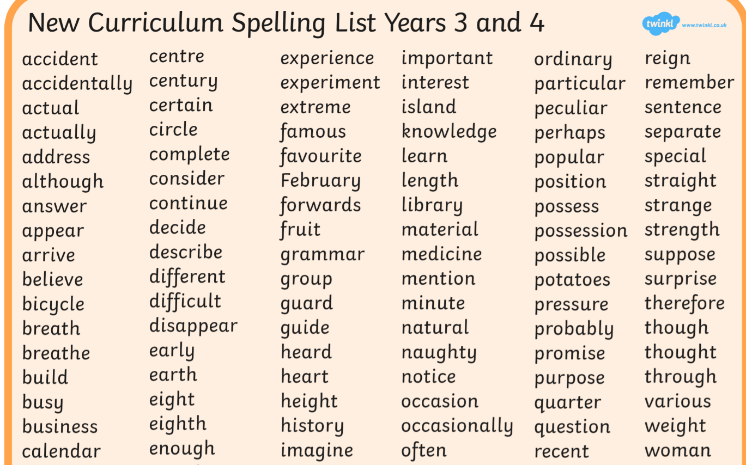
Spellings

Slide 11
Reading

Slide 12
Reading
Children have a reading book with a zpd number on the side.
The children should read at home daily their home reading book and encourage them to read other books for example books from the library.
Whether the children move up a level or not depends on them completing online questions about what they read to show they have understood what they read.

Slide 13
Curriculum
History – Anglo-Saxons, Vikings, Normans and Victorians
Geography – Earthquakes, Rainforests, Canada
Science – Solids and Liquids, sound, digestion, teeth, electricity, food chains
Art – 3d sketching, sculpture, weaving
PE – will be swimming after Christmas and letters will be sent
Trips – Stafford Castle for our history topic and an RE trip to the mosque and a church
At St James, we nurture the whole child. Our curriculum recognises children’s prior learning experiences and is carefully designed to enrich and inspire pupils to become successful learners. We want our children to be brave, responsible, independent, communicators who are knowledgeable and self-motivated. The curriculum, and supplementary experiences at St James, are integral in developing these and supporting lifelong learning and future success.

Slide 14
Multiplication Check
The Multiplication Tables Check (MTC) is a key stage 2 assessment to be taken by pupils at the end of year 4 (in June). The purpose of the MTC is to make sure the times tables knowledge is at the expected level.
The MTC is an online test where the pupils are asked 25 questions on times tables 2 to 12. For every question you have 6 seconds to answer and in between the questions there is a 3-second rest. Questions about the 6, 7, 8, 9, and 12 times table come up more often. The questions are generated randomly based on the rules of the MTC.
How to prepare
A good way to prepare is start early and build a daily routine practising the times tables. With regular practise you will learn all the questions and gain confidence.
We suggest practising 10 to 15 minutes a day for optimal results.
You can use tt rockstars to practise.

Slide 15
URGENT
Please check emails regularly and ensure that contact.us@stjamespri.uk is added to safe senders list.
Communication will be via email, Arbor App and school website moving forwards.
Parents were also sent a link to fill out medication information and asked to bring in medication like inhalers please do so if you haven’t.

Slide 16
Thank you for attending today!

